Slide 1
How to Withdraw from
ACC Classes
College Prep
Mr. Gordon
jgordon@bisdtx.org

Slide 2
Upcoming Events
Fri. Nov. 19th Picture Day
BISD Thanksgiving Break Nov. 22-26 (You still have ACC Monday, Tuesday, and Wednesday)
Sat. Dec. 4th Winter Dance All Grades are Invited
hi

Slide 3

How to Withdraw from ACC Classes
Thursday, Nov. 18, 2021 is the last day to Withdraw from Fall ACC Classes.
It is important to remember that the student is the person who is ultimately responsible for withdrawing from a class.
Mr. Gordon and Mr. Longoria can advise and assist you, but the student is responsible.
hi

Slide 4
How to Withdraw from ACC Classes
Below is the agreement that you and your guardian are required to sign when dropping a class.
The form is on the last slide and in the Google Classroom.
“By dropping a course, I understand that I could forfeit my chances of obtaining my Associate degree and that it can detrimentally impact my academic standing and SAP for financial aid in the future. Courses that need to be taken again will be paid by me and my family at $150, per course. If books are required, it is my responsibility to purchase my books for retakes. Parent signature required for drops. Payment is due before ACC Spring classes begin on January 18, 2022.”
hi

Slide 5
What Does Withdraw Mean?
You will receive a W (for withdrawal) on your college transcript.
A withdrawal does not affect your GPA (Grade Point Average). Due to S.A.P. (Satisfactory Academic Progress), however, you have a limited number of withdrawals.
If the class is required for high school or your Associate Degree, then you will need to retake the class next semester or over the summer.
You will be responsible for paying the $150 for retaking the class.
hi

Slide 6
How to Withdraw from ACC Classes
On the following slides, is a step-by-step overview of how to withdraw from an ACC course.
hi

Slide 7
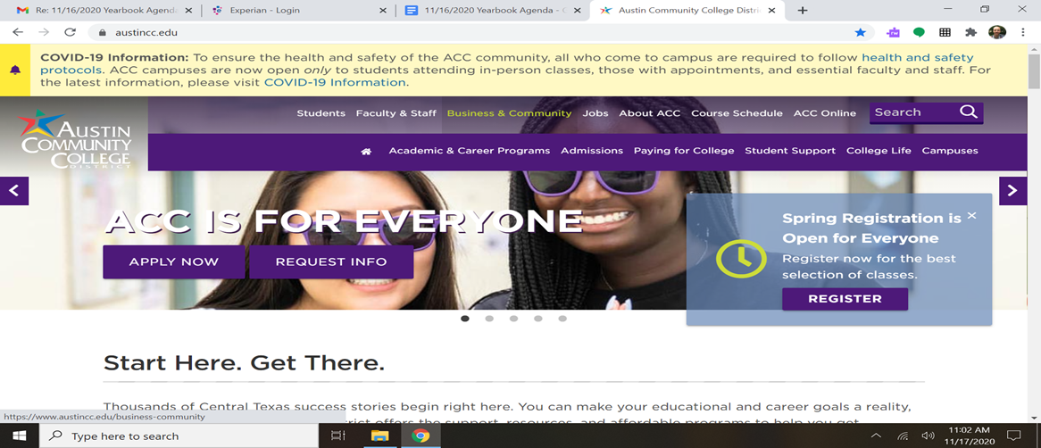
How to Withdraw from ACC Classes
Step 1: Go to austincc.edu and click on “Students” at the top of the page.
hi

Slide 8
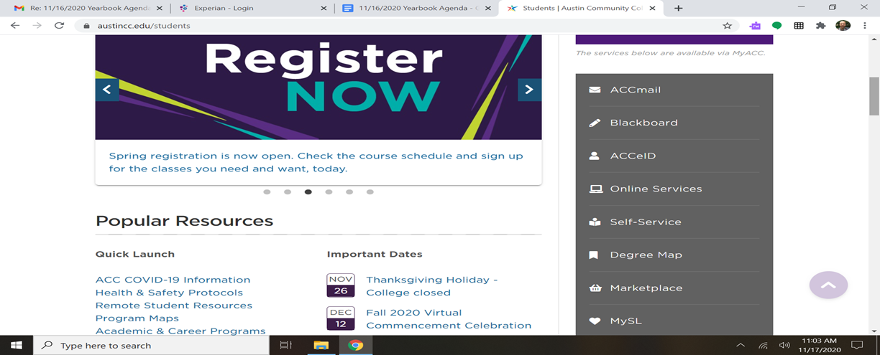
How to Withdraw from ACC Classes
Step 2: Choose “Online Services” on the right side.
hi

Slide 9
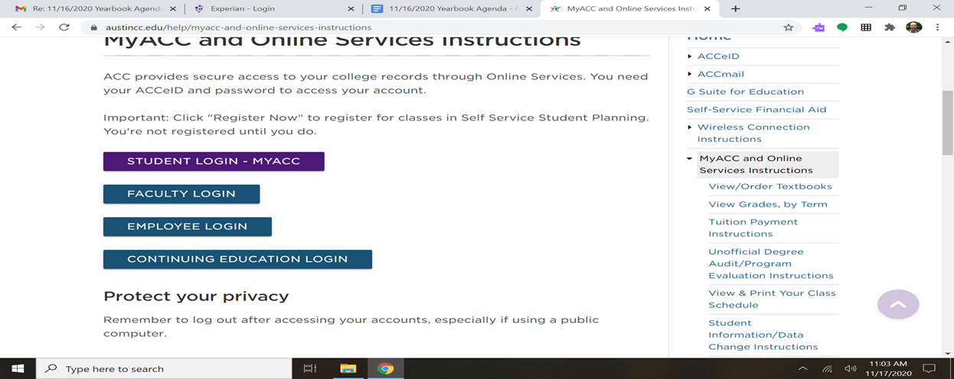
How to Withdraw from ACC Classes
Step 3: Login
hi

Slide 10
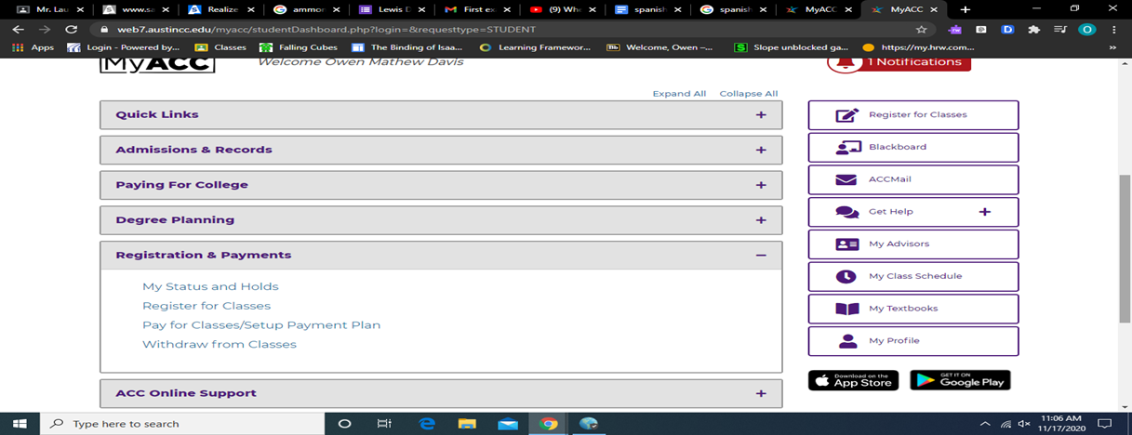
How to Withdraw from ACC Classes
Step 4: Once logged in, choose “Registration & Payments”, and then “Withdraw from Classes”.
hi

Slide 11
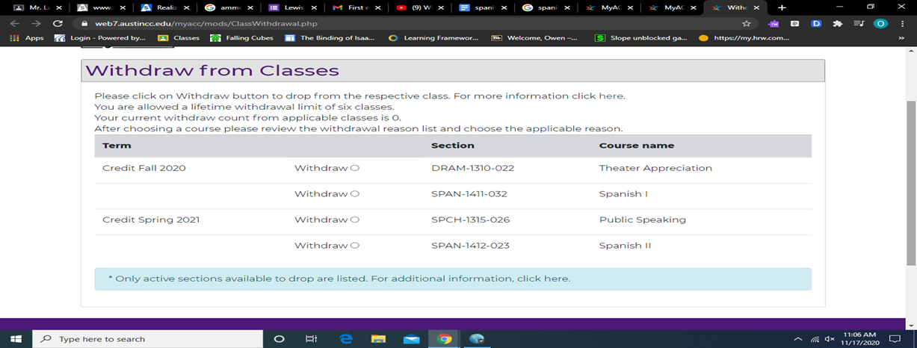
How to Withdraw from ACC Classes
Step 5: Scroll down to “Withdraw from Classes”, click the bubble for the class you wish to withdraw from.
hi

Slide 12
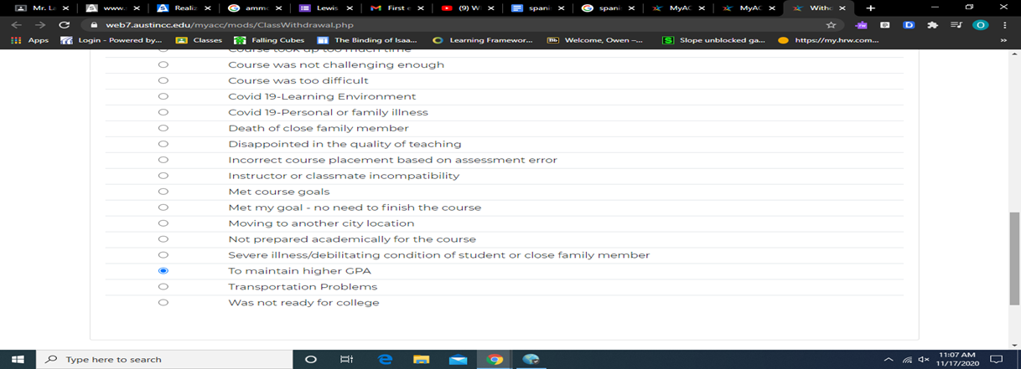
How to Withdraw from ACC Classes
Step 6: Scroll down and choose “To maintain higher GPA” for the reason to withdraw and click confirm. You will receive a confirmation box once you submit.
You are now no longer in that class.
hi

Slide 13
How to Withdraw from ACC Classes
Step 7: The last step is to complete the Student Drop Form and have a parent/ guardian sign it. Please submit it to Mr. Longoria. Mr. Longoria needs to know if you have dropped a class in order to plan for future semesters.
This form can be found in English here and Spanish here, in the Front Office or Mr. Gordon’s Google Classroom.
hi

